Slide 1
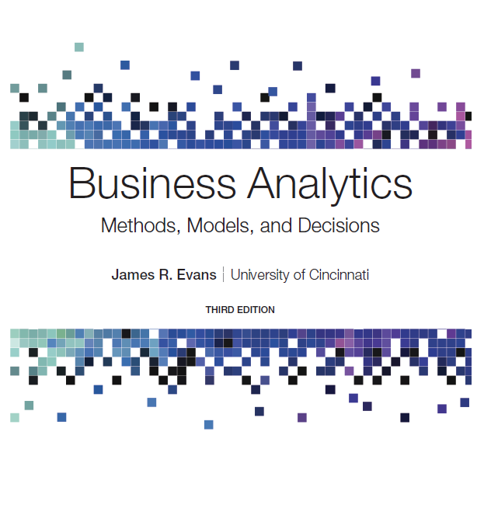
Business Analytics: Methods, Models, and Decisions
Third Edition
Chapter 4
Descriptive Statistics
Copyright © 2020, 2016, 2013 Pearson Education, Inc. All Rights Reserved
Notes:
If this PowerPoint presentation contains mathematical equations, you may need to check that your computer has the following installed:
1) MathType Plugin
2) Math Player (free versions available)
3) NVDA Reader (free versions available)

Slide 2
Statistics
Statistics, as defined by David Hand, past president of the Royal Statistical Society in the U K, is both the science of uncertainty and the technology of extracting information from data.
Statistics involves collecting, organizing, analyzing, interpreting, and presenting data.
A statistic is a summary measure of data.
Descriptive statistics refers to methods of describing and summarizing data using tabular, visual, and quantitative techniques.

Slide 3
Metrics and Data Classification
Metric - a unit of measurement that provides a way to objectively quantify performance.
Measurement - the act of obtaining data associated with a metric.
Measures - numerical values associated with a metric.

Slide 4
Types of Metrics
Discrete metric - one that is derived from counting something.
For example, a delivery is either on time or not; an order is complete or incomplete; or an invoice can have one, two, three, or any number of errors. Some discrete metrics would be the proportion of on-time deliveries; the number of incomplete orders each day, and the number of errors per invoice.
Continuous metrics are based on a continuous scale of measurement.
Any metrics involving dollars, length, time, volume, or weight, for example, are continuous.

Slide 5
Measurement Scales
Categorical (nominal) data - sorted into categories according to specified characteristics.
Ordinal data - can be ordered or ranked according to some relationship to one another.
Interval data - ordinal but have constant differences between observations and have arbitrary zero points.
Ratio data - continuous and have a natural zero.

Slide 6
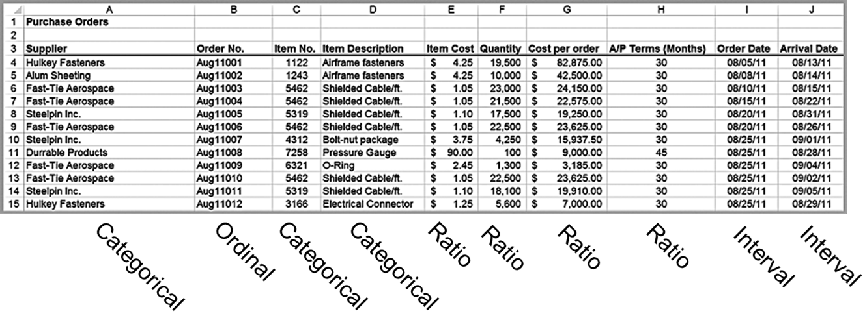
Example 4.1: Classifying Data Elements

Slide 7
Frequency Distributions and Histograms
A frequency distribution is a table that shows the number of observations in each of several nonoverlapping groups.
A graphical depiction of a frequency distribution in the form of a column chart is called a histogram.

Slide 8
Frequency Distributions for Categorical Data
Categorical variables naturally define the groups in a frequency distribution.
To construct a frequency distribution, we need only count the number of observations that appear in each category.
This can be done using the Excel COUNT IF function.

Slide 9
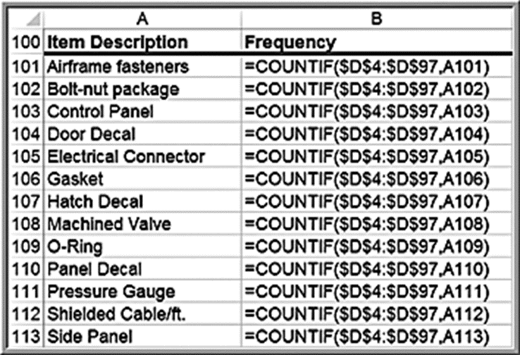
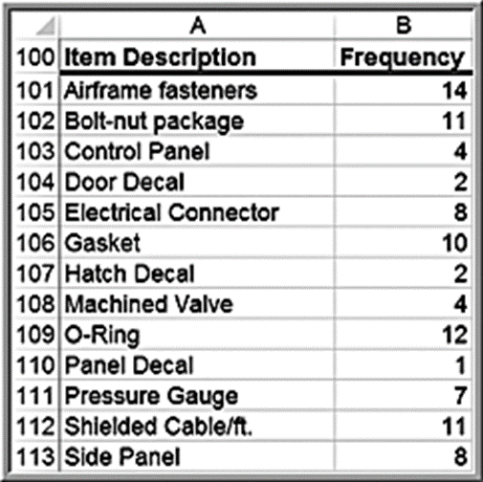
Example 4.2: Constructing a Frequency Distribution for Items in the Purchase Orders Database (1 of 2)
List the item names in a column on the spreadsheet.
Use the function
where
is the cell containing the item name.

Slide 10
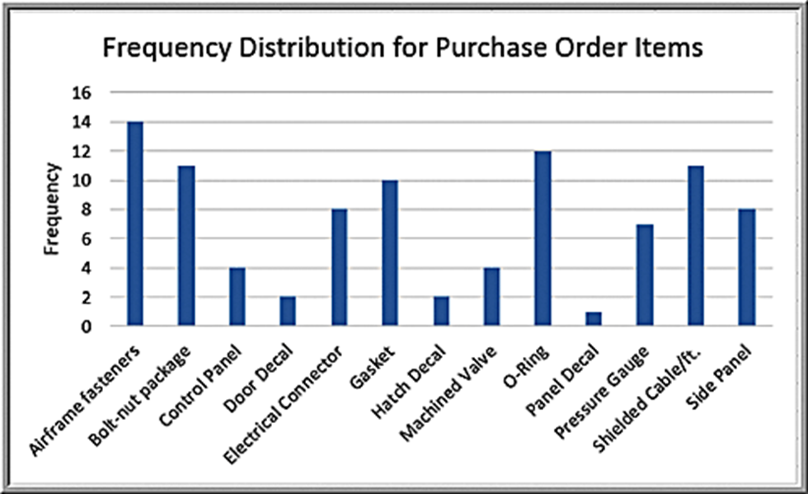
Example 4.2: Constructing a Frequency Distribution for Items in the Purchase Orders Database (2 of 2)
Construct a column chart to visualize the frequencies.

Slide 11
Relative Frequency Distributions
Relative frequency is the fraction, or proportion, of the total.
If a data set has n observations, the relative frequency of category i is:
We often multiply the relative frequencies by 100 to express them as percentages.
A relative frequency distribution is a tabular summary of the relative frequencies of all categories.

Slide 12
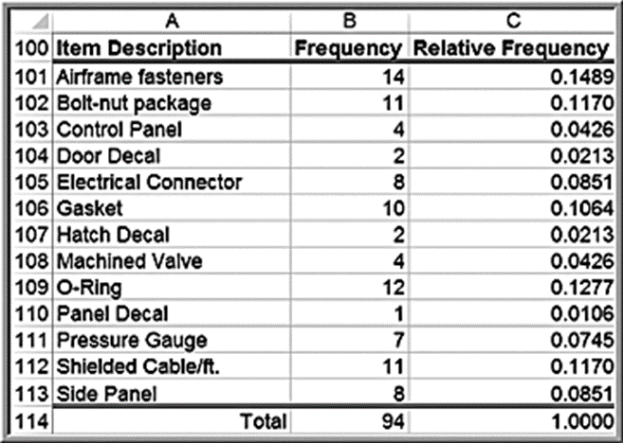
Example 4.3: Constructing a Relative Frequency Distribution for Items in the Purchase Orders Database
First, sum the frequencies to find the total number (note that the sum of the frequencies must be the same as the total number of observations, n).
Then divide the frequency of each category by this value.

Slide 13
Frequency Distributions for Numerical Data
For numerical data that consist of a small number of discrete values, we may construct a frequency distribution similar to the way we did for categorical data; that is, we simply use COUNT IF to count the frequencies of each discrete value.

Slide 14
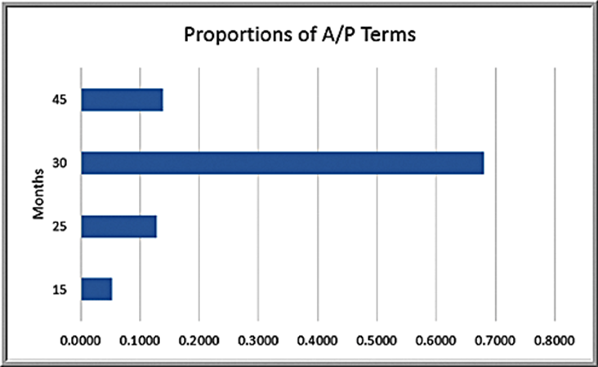
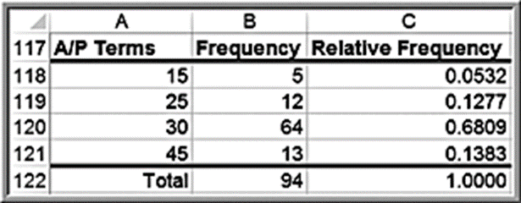
Example 4.4: Frequency and Relative Frequency Distribution for Start fraction a over p end fraction Terms
In the Purchase Orders data, the
terms are all whole
numbers 15, 25, 30, and 45.

Slide 15
Excel Histogram Tool
Frequency distributions and histograms can be created using the Analysis Toolpak in Excel.
Click the Data Analysis tools button in the Analysis group under the Data tab in the Excel menu bar and select Histogram from the list.

Slide 16
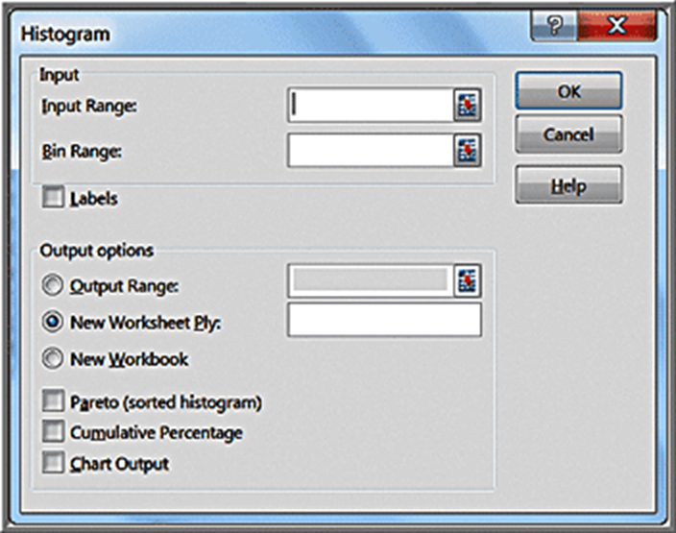
Histogram Dialog
Specify the Input Range corresponding to the data. If you include the column header, then also check the Labels box so Excel knows that the range contains a label. The Bin Range defines the groups (Excel calls these “bins”) used for the frequency distribution.

Slide 17
Using Bin Ranges
If you do not specify a bin range, Excel will automatically determine bin values for the frequency distribution and histogram, which often results in a rather poor choice.
If you have discrete values, set up a column of these values in your spreadsheet for the bin range and specify this range in the Bin Range field.

Slide 18
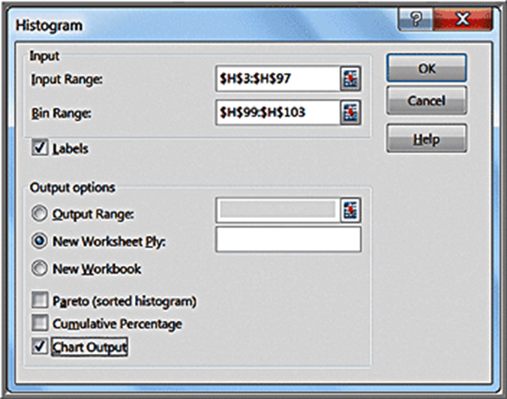
Example 4.5: Using the Histogram Tool (1 of 2)
We will create a frequency distribution and histogram for the A/P Terms variable in the Purchase Orders database.
We defined the bin range below the data in cells
Month
15
25
30
45

Slide 19
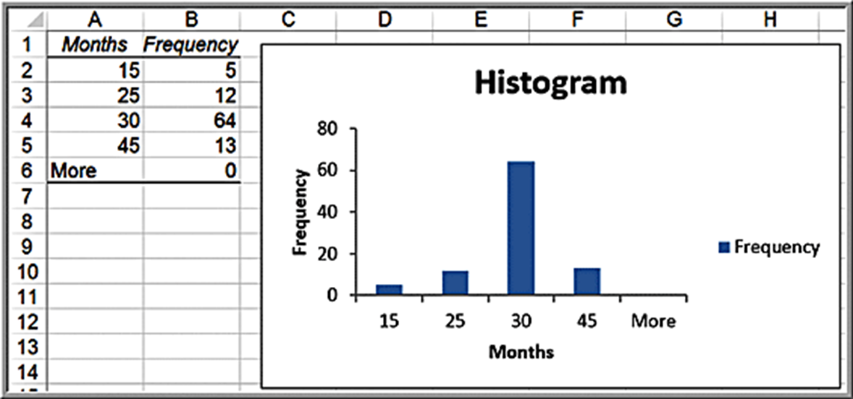
Example 4.5 Using the Histogram Tool (2 of 2)
Histogram tool results:

Slide 20
Grouped Frequency Distributions
For numerical data that have many different discrete values with little repetition or are continuous, a frequency distribution requires that we define by specifying
the number of groups,
the width of each group, and
the upper and lower limits of each group.
Choose between 5 to 15 groups, and the range of each should be equal.
Choose the lower limit of the first group (L L) as a whole number smaller than the minimum data value and the upper limit of the last group (U L) as a whole number larger than the maximum data value.

Slide 21
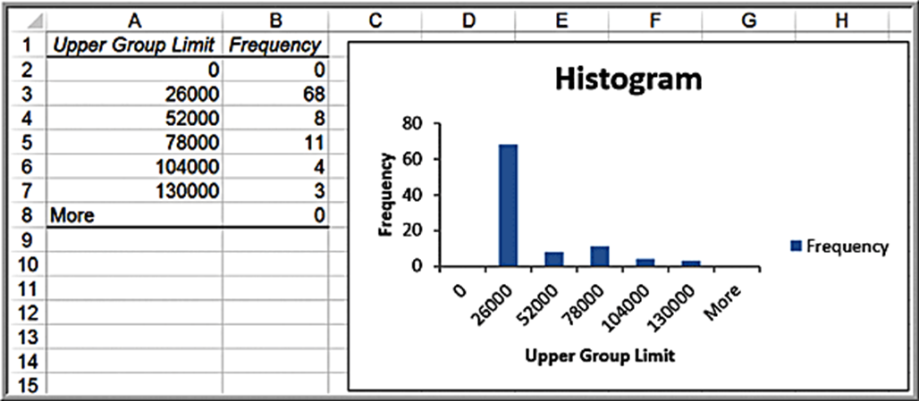
Example 4.6: Constructing a Frequency Distribution and Histogram for Cost Per Order(1 of 2)
The data range from a minimum of $68.75 to a maximum of $127,500; set the lower limit of the first group to $0 and the upper limit of the last group to $130,000.
If we select 5 groups, using equation (3.2) the width of each group is

Slide 22
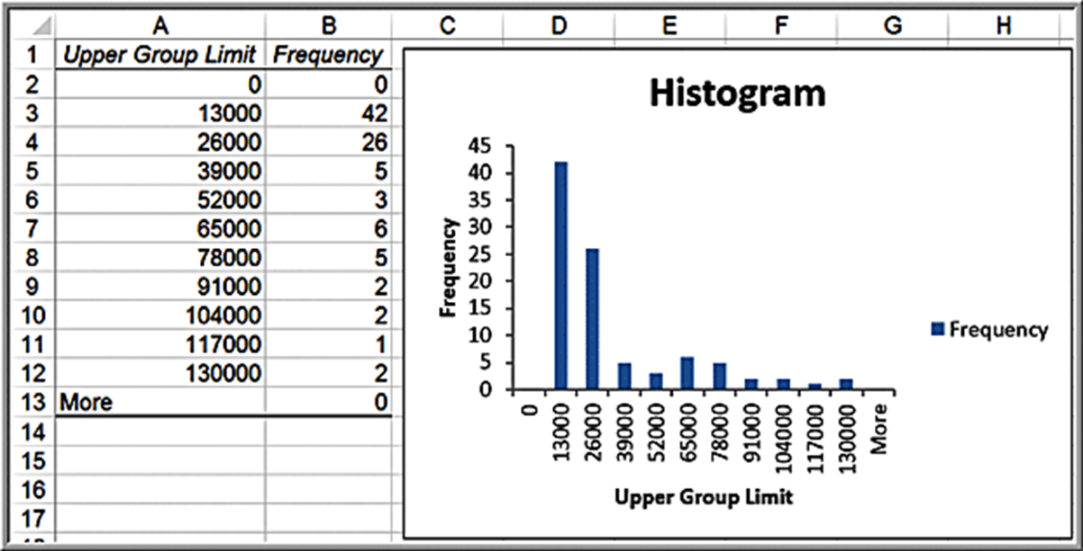
Example 4.6: Constructing a Frequency Distribution and Histogram for Cost Per Order (2 of 2)
Ten-group histogram

Slide 23
Cumulative Relative Frequency Distributions
The cumulative relative frequency represents the proportion of the total number of observations that fall at or below the upper limit of each group.
A tabular summary of cumulative relative frequencies is called a cumulative relative frequency distribution.

Slide 24
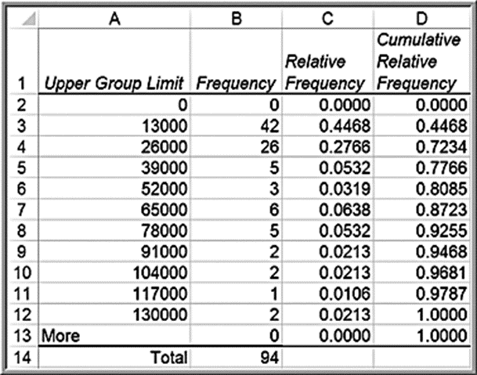
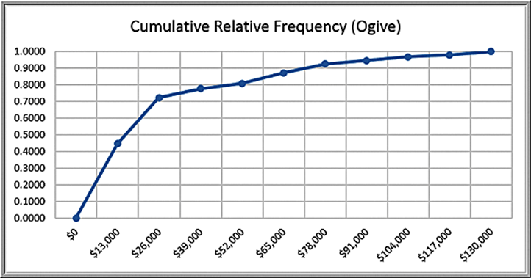
Example 4.7: Computing Cumulative Relative Frequencies
Set the cumulative relative frequency of the first group equal to its relative frequency. Then add the relative frequency of the next group to the cumulative relative frequency.
For example, the cumulative relative frequency in cell D3 is computed as =D2+C3 = 0.000 + 0.4468 = 0.4468.

Slide 25
Constructing Frequency Distributions Using PivotTables
In the Purchase Orders data, we can simply build a PivotTable to find a count of the number of orders for each item.
For continuous numerical data, we can also use PivotTables to construct a grouped frequency distribution.

Slide 26
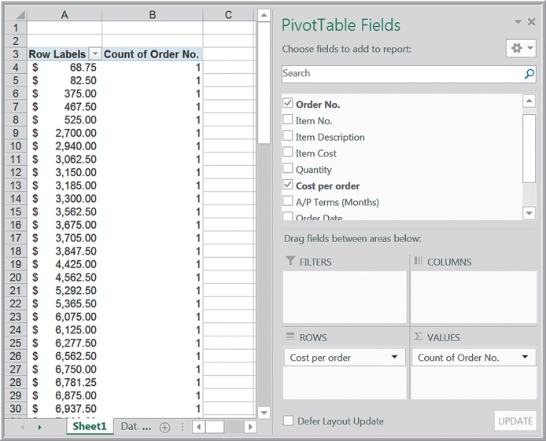
Example 4.8:Constructing a Grouped Frequency Distribution Using PivotTables (1 of 3)
Using the Purchase Orders database, create a PivotTable as shown:

Slide 27
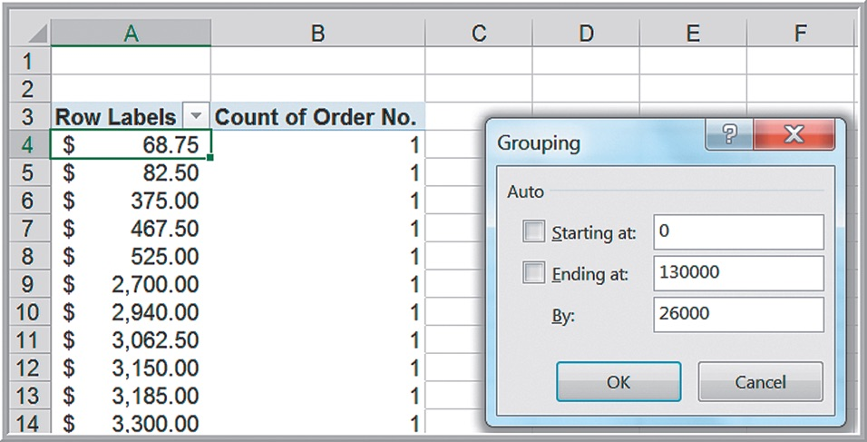
Example 4.8:Constructing a Grouped Frequency Distribution Using PivotTables (2 of 3)
Click on any value in the Row Labels column, and from the Analyze tab for PivotTable Tools, select Group Field. Edit the dialog to start at 0 and end at 130000, and use 26000 as the group range.

Slide 28
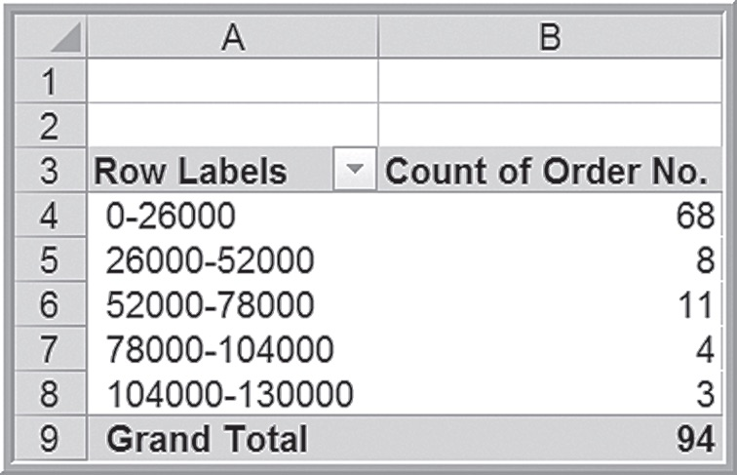
Example 4.8:Constructing a Grouped Frequency Distribution Using PivotTables (3 of 3)
Grouped frequency distribution results:

Slide 29
Percentiles
The k^{th} percentile is a value at or below which at least k percent of the observations lie. The most common way to compute the k^{th} percentile is to order the data values from smallest to largest and calculate the rank of the k^{th} percentile using the formula:
Statistical software use different methods that often involve interpolating between ranks instead of rounding, thus producing different results.
The Excel function
computes the k^{th}
percentile of data in the range specified in the array field, where k is in the range 0 to 1, inclusive (i.e., including 0 and 1).

Slide 30
Examples 4.9 and 4.10: Computing Percentiles
Compute the 90th percentile for Cost per order in the Purchase Orders data.
Rank of k^{th} percentile
n = 94; k = 90
For the 90th percentile, the rank is
Value of the 85th observation = $74,375
Using the Excel function
percentile is
$73,737.50, which is different from using formula (3.3).

Slide 31
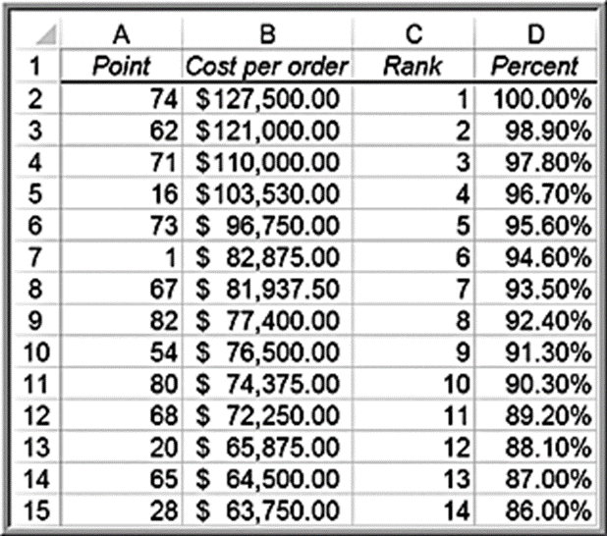
Example 4.11: Excel Rank and Percentile Tool
90.3rd percentile= $74,375
(same result as manually computing the 90th percentile)
The Excel value of the 90th percentile that was computed in Example 4.9 as $74,375 is the 90.3rd percentile value.

Slide 32
Quartiles
Quartiles break the data into four parts.
The 25th percentile is called the first quartile,Q1;
the 50th percentile is called the second quartile, Q2;
the 75th percentile is called the third quartile, Q3; and
the 100th percentile is the fourth quartile, Q4.
One-fourth of the data fall below the first quartile, one-half are below the second quartile, and three-fourths are below the third quartile.
Excel function
where
array specifies the range of the data and quart is a whole number between 1 and 4, designating the desired quartile

Slide 33
Example 4.12: Computing Quartiles in Excel
Compute the Quartiles of the Cost per Order data
First quartile:
Second quartile:
Third quartile:
Fourth quartile:

Slide 34
Cross-Tabulations
A cross-tabulation is a tabular method that displays the number of observations in a data set for different subcategories of two categorical variables.
A cross-tabulation table is often called a contingency table.
The subcategories of the variables must be mutually exclusive and exhaustive, meaning that each observation can be classified into only one subcategory, and, taken together over all subcategories, they must constitute the complete data set.

Slide 35
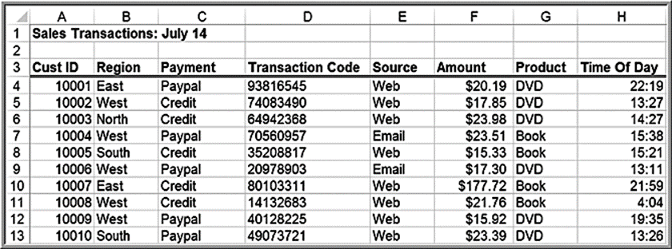
Example 4.13: Constructing a Cross-Tabulation
Sales Transactions database
Count the number (and compute the percentage) of books and D V Ds ordered by region (easy with PivotTables).
Region | Book | D V D | Total
East | 56 | 42 | 98
North | 43 | 42 | 85
South | 62 | 37 | 99
West | 100 | 90 | 190
Total | 261 | 211 | 472
Region | Book | D V D | Total
East | 57.1% | 42.9% | 100.0%
North | 50.6% | 49.4% | 100.0%
South | 62.6% | 37.4% | 100.0%
West | 52.6% | 47.4% | 100.0%

Slide 36
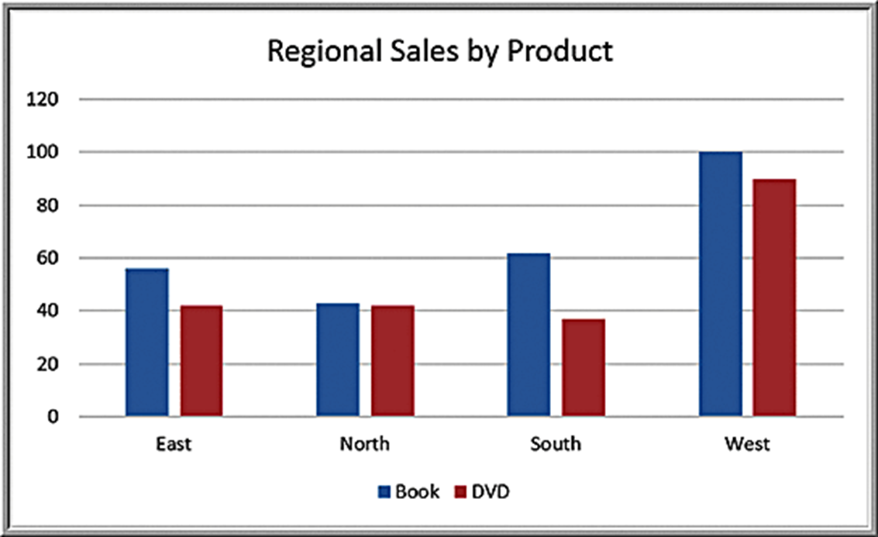
Cross-Tabulation Visualization: Chart of Regional Sales by Product

Slide 37
Populations and Samples
Population - all items of interest for a particular decision or investigation
all married drivers over 25 years old
all subscribers to Netflix
Sample - a subset of the population
a list of individuals who rented a comedy from Netflix in the past year
The purpose of sampling is to obtain sufficient information to draw a valid inference about a population.

Slide 38
Understanding Statistical Notation
We typically label the elements of a data set using
subscripted variables,
represents the i^{th} observation.
It is common practice in statistics to use Greek letters,
such as
to represent
population measures and italic letters such as by
(called x-bar), s, and p to represent sample statistics.
N represents the number of items in a population and n represents the number of observations in a sample.
Capital Greek sigma represents summation:

Slide 39
Measures of Location: Arithmetic Mean
Population mean:
Sample mean:
Excel function: = AVERAGE(data range)
Property of the mean:
Outliers can affect the value of the mean.

Slide 40
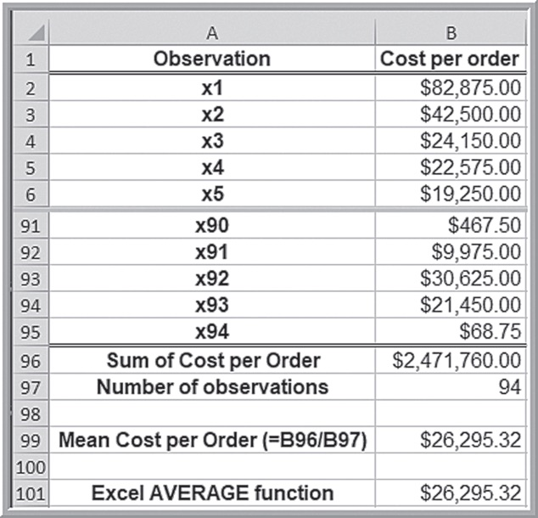
Example 4.14: Computing Mean Cost Per Order
Purchase Orders database
Using formula (4.5):
Using Excel AVERAGE Function

Slide 41
Measures of Location: Median
The median specifies the middle value when the data are arranged from least to greatest.
Half the data are below the median, and half the data are above it.
For an odd number of observations, the median is the middle of the sorted numbers.
For an even number of observations, the median is the mean of the two middle numbers.
We could use the Sort option in Excel to rank-order the data and then
determine the median. The Excel function
could
also be used.
The median is meaningful for ratio, interval, and ordinal data.
Not affected by outliers.

Slide 42
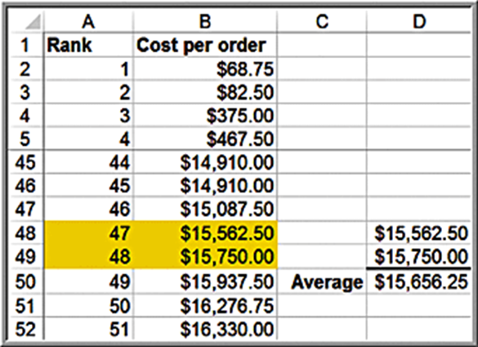
Example 4.15: Finding the Median Cost Per Order
Sort the data from smallest to largest. Since we have 90 observations, the median is the average of the 47th and 48th observation.

Slide 43
Measures of Location: Mode
The mode is the observation that occurs most frequently.
The mode is most useful for data sets that contain a relatively small number of unique values.
You can easily identify the mode from a frequency distribution by identifying the value or group having the largest frequency or from a histogram by identifying the highest bar.
Excel function:
For multiple modes:

Slide 44


Example 4.16: Finding the Mode
Purchase Orders database:
terms
Mode = 30 months
Cost per order
Mode is the group between $0 and $13,000.

Slide 45
Measures of Location: Midrange
The midrange is the average of the greatest and least values in the data set.
Caution must be exercised when using the midrange because extreme values easily distort the result. This is because the midrange uses only two pieces of data, whereas the mean uses all the data; thus, it is usually a much rougher estimate than the mean and is often used for only small sample sizes.

Slide 46
Example 4.17: Computing the Midrange
Purchase Orders data
Use the Excel MIN and MAX functions or sort the data and find them easily.
Cost per order midrange:

Slide 47
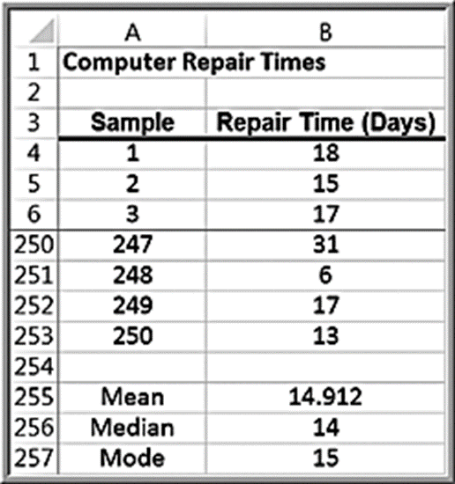
Example 4.18:Quoting Computer Repair Times (1 of 2)
The Excel file Computer Repair Times includes 250 repair times for customers.
What repair time would be reasonable to quote to a new customer?
Median repair time is 2 weeks; mean and mode are about 15 days.
Examine the histogram.

Slide 48
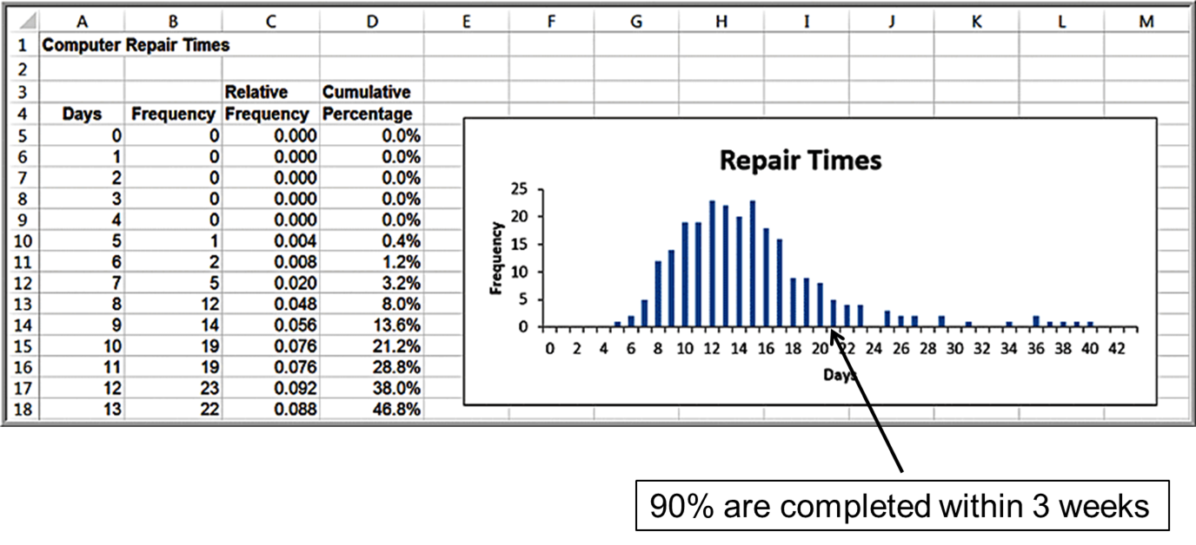
Example 4.18:Quoting Computer Repair Times (2 of 2)

Slide 49
Measures of Dispersion
Dispersion refers to the degree of variation in the data; that is, the numerical spread (or compactness) of the data.
Key measures:
Range
Interquartile range
Variance
Standard deviation

Slide 50
Measures of Dispersion: Range
The range is the simplest and is the difference between the maximum value and the minimum value in the data set.
In Excel, compute as
The range is affected by outliers, and is often used only for very small data sets.

Slide 51
Example 4.19: Computing the Range
Purchase Orders data
For the cost per order data:
Maximum = $127,500
Minimum = $68.78
Range = $127,500 − $68.78 = $127,431.22

Slide 52
Measures of Dispersion: Interquartile Range
The interquartile range (I Q R), or the midspread is the difference between the first and third quartiles,
This includes only the middle 50% of the data and, therefore, is not influenced by extreme values.

Slide 53
Example 4.20: Computing the Interquartile Range
Purchase Orders data
For the Cost per order data:
Third Quartile =
First Quartile =
Interquartile Range = $27,593.75 − $6,757.81 =$20,835.94

Slide 54
Measures of Dispersion: Variance
The variance is the “average” of the squared deviations from the mean.
For a population:
In Excel:
For a sample:
In Excel:
Note the difference in denominators!

Slide 55
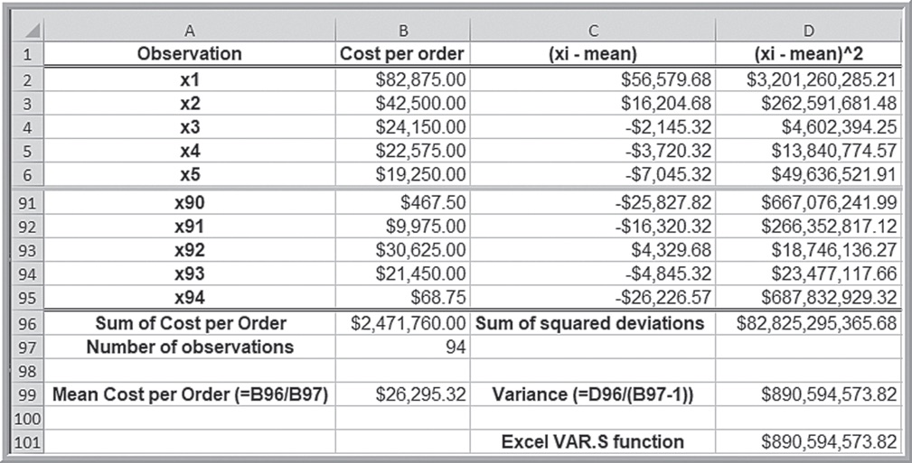
Example 4.21: Computing the Variance
Purchase Orders Cost per order data

Slide 56
Measures of Dispersion: Standard Deviation
The standard deviation is the square root of the variance.
Note that the dimension of the variance is the square of the dimension of the observations, whereas the dimension of the standard deviation is the same as the data. This makes the standard deviation more practical to use in applications.
For a population:
In Excel:
For a sample:
In Excel:

Slide 57
Example 4.22: Computing the Standard Deviation
Purchase Orders Cost per order data
Using the results of Example 4.21, take the square root of the variance:
Alternatively, use the Excel function

Slide 58
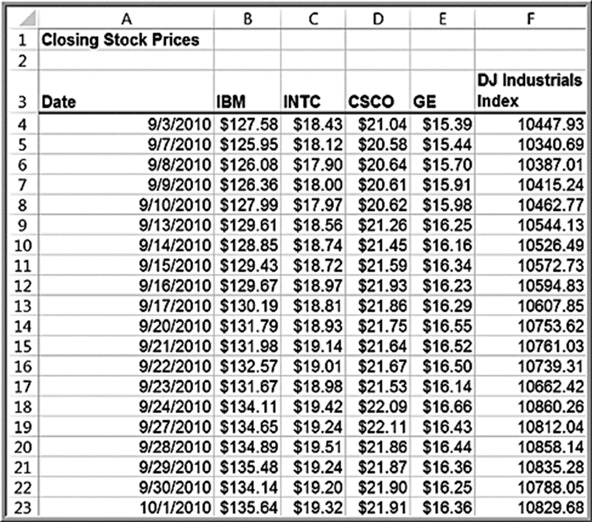
Standard Deviation as a Measure of Risk
Excel file: Closing Stock Prices
Intel (I N T C):
Mean = $18.81
Standard deviation = $0.50
General Electric (G E):
Mean = $16.19
Standard deviation = $0.35
I N T C is a higher risk investment than G E.

Slide 59
Chebyshev’s Theorem
For any data set, the proportion of values that lie
within
standard deviations of the mean is
at least
Examples:
For k = 2: at least
or 75% of the data lie within two
standard deviations of the mean
For k = 3: at least
or 89% of the data lie within three
standard deviations of the mean

Slide 60
Example 4.23: Applying Chebyshev’s Theorem
Purchase Orders database
A two-standard-deviation interval around the mean is [-$33,390.34, $85,980.98].
89 of 94, or 94.7%, of the observations fall in this interval.
A three-standard-deviation interval is [-$63,233.17, $115,823.81]
92 of 94, or 97.9%, fall in this interval

Slide 61
Empirical Rules
For many data sets encountered in practice:
Approximately 68% of the observations fall within one
standard deviation of the mean
Approximately 95% fall within two standard deviations of
the mean
Approximately 99.7% fall within three standard deviations
of the mean
These rules are commonly used to characterize the natural variation in manufacturing processes and other business phenomena.

Slide 62
Process Capability Index
The process capability index
is a measure of
how well a manufacturing process can achieve specifications.
Using a sample of output, measure the dimension of interest and compute the total variation using the third empirical rule.
Compare results to specifications using:

Slide 63
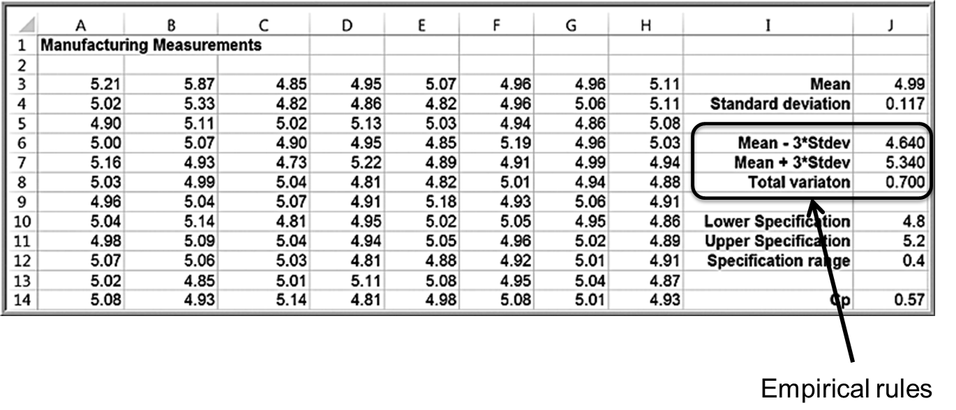
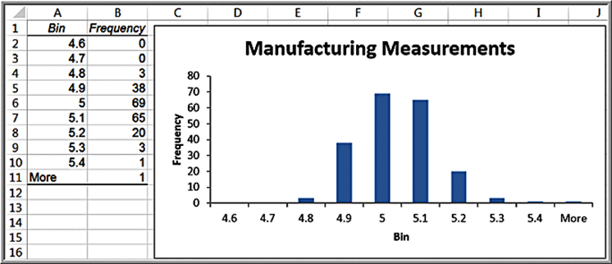
Example 4.24: Using Empirical Rules to Measure the Capability of a Manufacturing Process

Slide 64
Standardized Values
A standardized value, commonly called a z-score, provides a relative measure of the distance an observation is from the mean, which is independent of the units of measurement.
The z-score for the i^{th} observation in a data set is calculated as follows:
Excel function:

Slide 65
Properties of z-Scores
The numerator represents the distance that
is from the
sample mean; a negative value indicates that
lies to
the left of the mean, and a positive value indicates that it lies to the right of the mean. By dividing by the standard deviation, s, we scale the distance from the mean to express it in units of standard deviations. Thus,
a z-score of 1.0 means that the observation is one standard deviation to the right of the mean;
a z-score of -1.5 means that the observation is 1.5 standard deviations to the left of the mean.

Slide 66
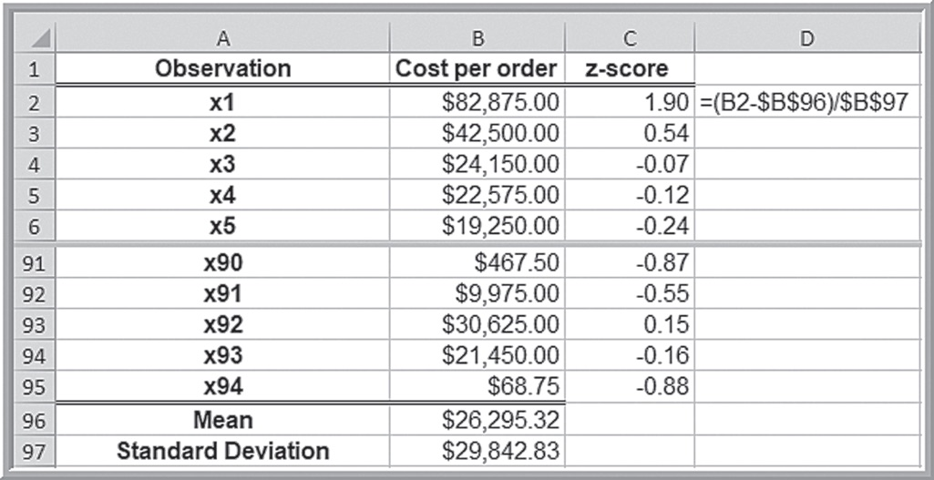
Example 4.25: Computing z-Scores
Purchase Orders Cost per order data

Slide 67
Coefficient of Variation
The coefficient of variation (C V) provides a relative measure of dispersion in data relative to the mean:
Sometimes expressed as a percentage.
Provides a relative measure of risk to return.
Return to risk =
is often easier to interpret,
especially in financial risk analysis.
The Sharpe ratio is a related measure in finance.

Slide 68
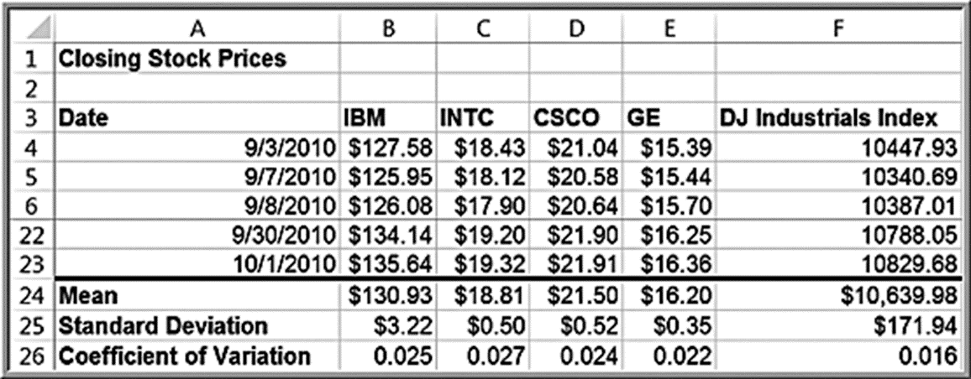
Example 4.26: Applying the Coefficient of Variation
Closing Stock Prices worksheet
Intel (I N T C) is slightly riskier than the other stocks.
The Index fund has the least risk (lowest C V).

Slide 69
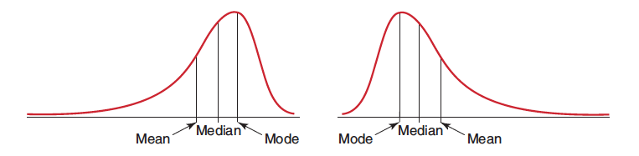
Measures of Shape: Skewness
Skewness describes the lack of symmetry of data.
Distributions that tail off to the right are called positively skewed; those that tail off to the left are said to be negatively skewed.
Negatively skewed
Positively skewed

Slide 70
Coefficient of Skewness
Coefficient of Skewness (CS):
Excel function: =SKEW(data range)
CS is negative for left-skewed data.
CS is positive for right-skewed data.
suggests high degree of skewness.
suggests moderate skewness.
suggests relative symmetry.

Slide 71
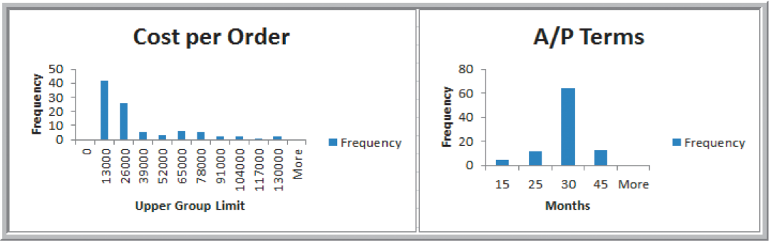
Example 4.27: Measuring Skewness
Purchase Orders database
Cost per order data: CS = 1.66 (high positive skewness)
A/P terms data: CS = 0.60 (more symmetric)

Slide 72
Measures of Shape: Kurtosis
Kurtosis refers to the peakedness (i.e., high, narrow) or flatness (i.e., short, flat-topped) of a histogram.
The coefficient of kurtosis (C K) measures the degree of kurtosis of a population
C K < 3 indicates the data is somewhat flat with a wide degree of dispersion.
C K > 3 indicates the data is somewhat peaked with less dispersion.

Slide 73
Excel Function for Kurtosis
Excel computes kurtosis differently; the function K U R T(data range) computes “excess kurtosis” for sample data, which is C K - 3. (Excel does not have a corresponding function for a population).
Thus, to interpret kurtosis values in Excel, distributions with values less than 0 are more flat, while those with values greater than 0 are more peaked.

Slide 74
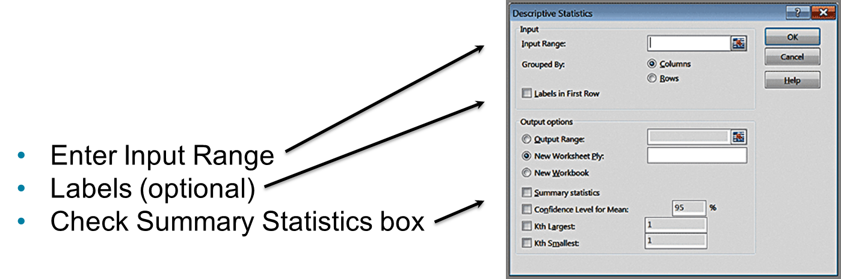
Excel Descriptive Statistics Tool
This tool provides a summary of numerical statistical measures for sample data.
The data must be in a single row or column. If the data are in multiple columns, the tool treats each row or column as a separate data set.

Slide 75
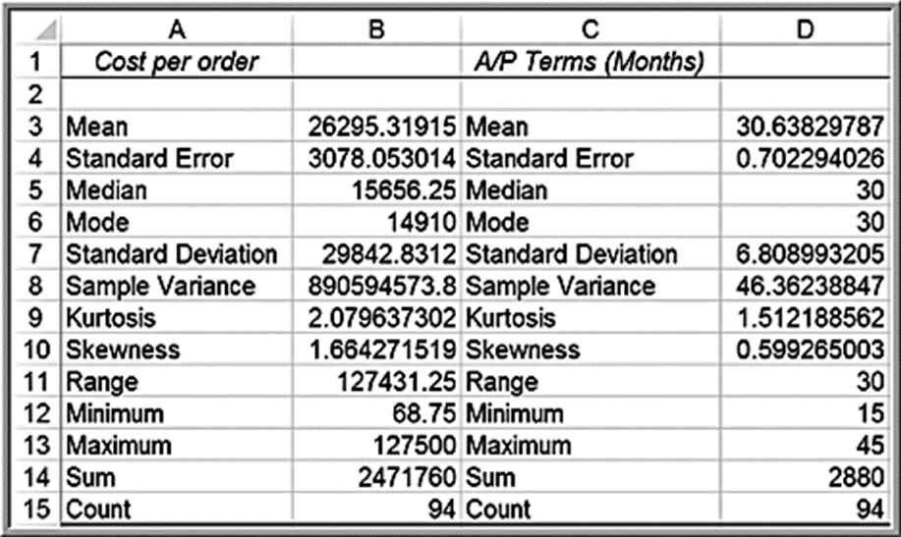
Example 4.28: Using the Descriptive Statistics Tool
Purchase Orders database
Note: Results of the Analysis Toolpak do not change when changes are made to the data.

Slide 76
Descriptive Statistics for Frequency Distributions
Population mean:
Sample mean:
Population variance:
Sample variance:

Slide 77
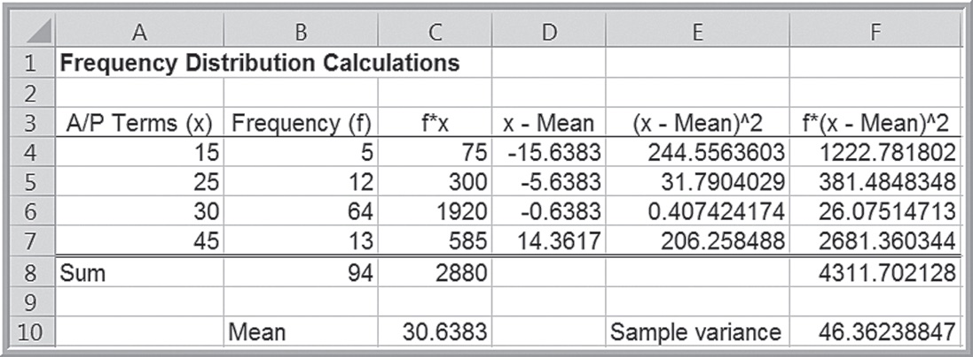
Example 4.29: Computing Statistical Measures from Frequency Distributions
Computer Repair Times

Slide 78
Grouped Data
If the data are grouped into k cells in a frequency distribution, we can use modified versions of the formulas to estimate the mean and variance by
replacing
with a representative value (such as the
midpoint, M) for all the observations in each cell
group and summing over all groups.

Slide 79
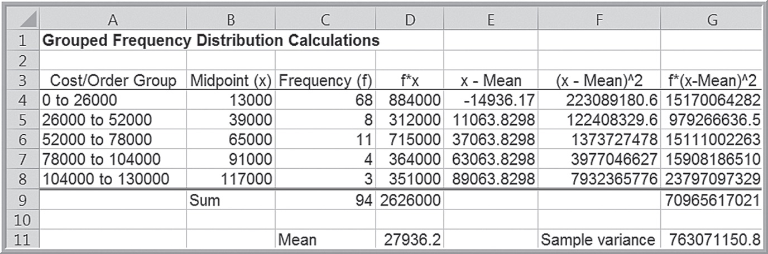
Example 4.30: Computing Descriptive Statistics for a Grouped Frequency Distribution

Slide 80
Descriptive Statistics for Categorical Data: The Proportion
The proportion, denoted by p, is the fraction of data that have a certain characteristic.
Proportions are key descriptive statistics for categorical data, such as defects or errors in quality control applications or consumer preferences in market research.

Slide 81
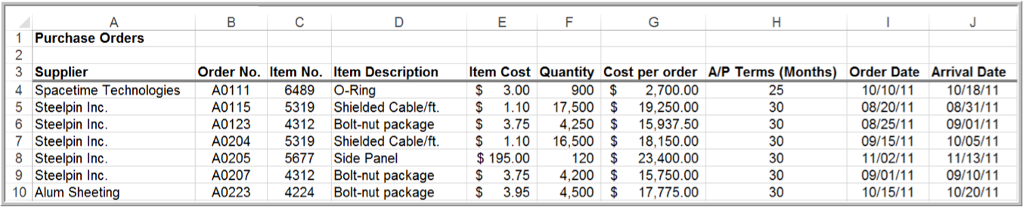
Example 4.31: Computing a Proportion
Proportion of orders placed by Spacetime Technologies

Slide 82
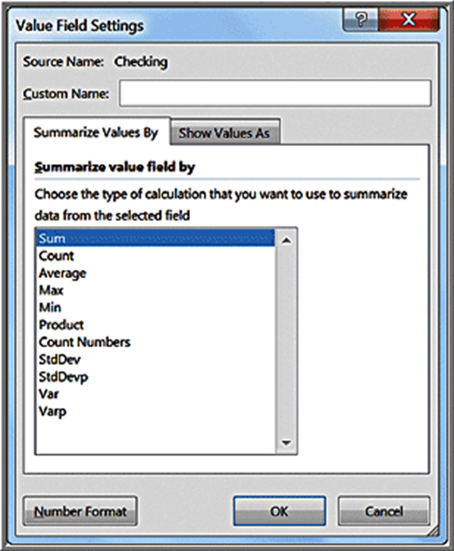
Statistics in PivotTables
Value Field Settings include several statistical measures:
Average
Max and Min
Product
Standard deviation
Variance

Slide 83
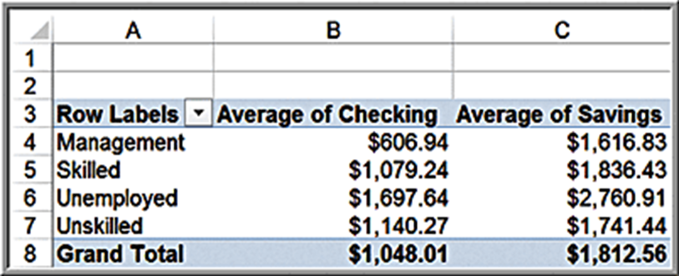
Example 4.32: Statistical Measures in PivotTables
Credit Risk Data
First, create a PivotTable.
In the PivotTable Field List, move Job to the Row Labels field and Checking and Savings to the Values field. Then change the field settings from “Sum of Checking” and “Sum of Savings” to the averages.

Slide 84
Measures of Association
Two variables have a strong statistical relationship with one another if they appear to move together.
When two variables appear to be related, you might suspect a cause-and-effect relationship.
Sometimes, however, statistical relationships exist even though a change in one variable is not caused by a change in the other.

Slide 85
Measures of Association: Covariance
Covariance is a measure of the linear association between two variables, X and Y. Like the variance, different formulas are used for populations and samples.
Population covariance:
Excel function:
Sample covariance:
Excel function:
The covariance between X and Y is the average of the product of the deviations of each pair of observations from their respective means.

Slide 86
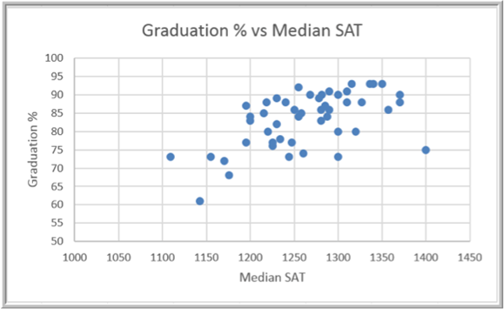
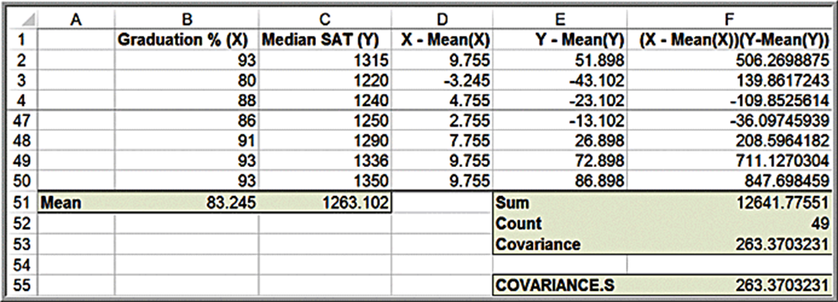
Example 4.33: Computing the Covariance
Colleges and Universities data

Slide 87
Measures of Association: Correlation
Correlation is a measure of the linear relationship between two variables, X and Y, which does not depend on the units of measurement.
Correlation is measured by the correlation coefficient, also known as the Pearson product moment correlation coefficient.
Correlation coefficient for a population:
Correlation coefficient for a sample:
The correlation coefficient is scaled between −1 and 1.
Excel function: =CORREL(array1,array2)

Slide 88
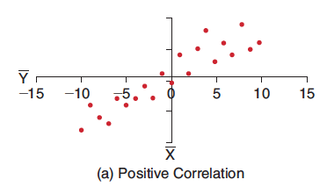
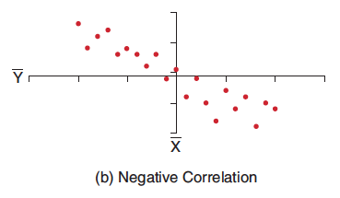
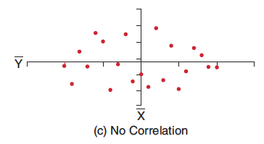
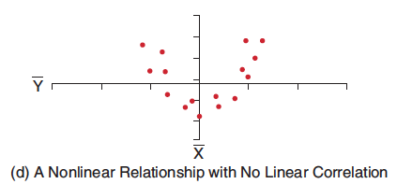
Examples of Correlation

Slide 89
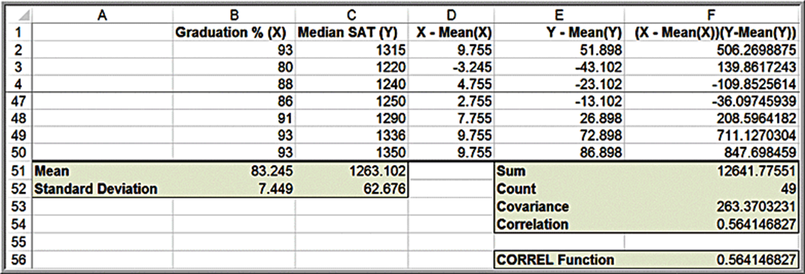
Example 4.34: Computing the Correlation Coefficient
Colleges and Universities data
Divide the covariance by the product of the standard deviations in cell F54.

Slide 90
Notes on the CORREL Function
When using the CORREL function, it does not matter if the data represent samples or populations. In other words,

Slide 91
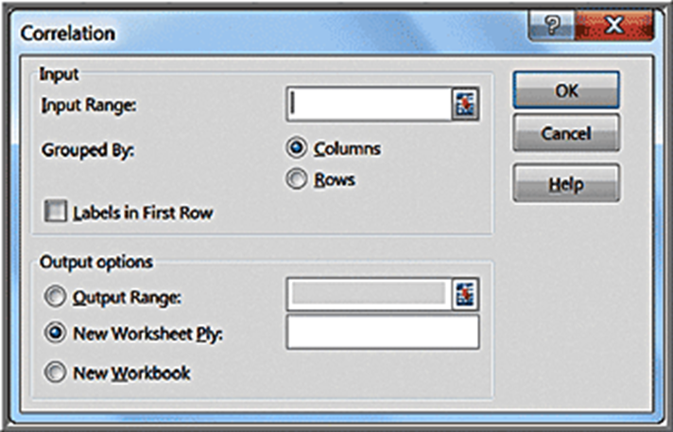
Excel Correlation Tool
Excel computes the correlation coefficient between all pairs of variables in the Input Range. Input Range data must be in contiguous columns.

Slide 92
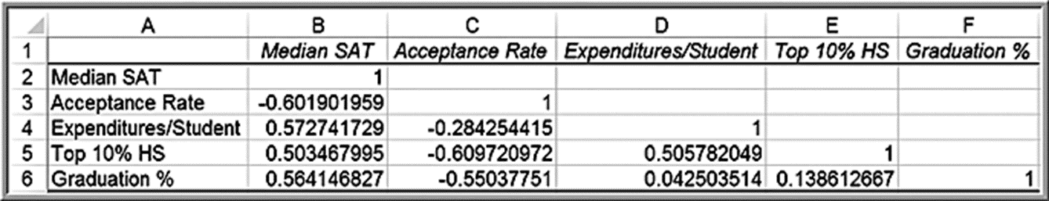
Example 4.35: Using the Correlation Tool
Colleges and Universities data
Moderate negative correlation between acceptance rate and graduation rate, indicating that schools with lower acceptance rates have higher graduation rates.
Acceptance rate is also negatively correlated with the median S A T and Top 10% H S, suggesting that schools with lower acceptance rates have higher student profiles.
The correlations with Expenditures/Student suggest that schools with higher student profiles spend more money per student.

Slide 93
Identifying Outliers
There is no standard definition of what constitutes an outlier.
Some typical rules of thumb:
z-scores greater than +3 or less than −3
Values more than
to the left of
or right of
Values between
to the left of
or right of

Slide 94
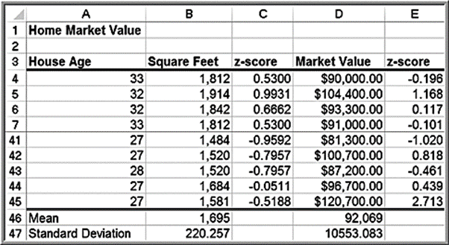

Example 4.36: Investigating Outliers
Home Market Value data
None of the z-scores exceed 3. However, while individual variables might not exhibit outliers, combinations of them might.
The last observation has a high market value ($120,700) but a relatively small house size (1,581 square feet) and may be an outlier.

Slide 95
Using Descriptive Statistics to Analyze Survey Data
Descriptive statistics tools are extremely valuable for summarizing and analyzing survey data.
Frequency distributions and histograms for the ratio variables
Descriptive statistical measures for the ratio variables using the Descriptive Statistics tool
Proportions for various attributes of the categorical variables in the sample
PivotTables that break down the averages of ratio variables
Cross-tabulations
Z-scores for examination of potential outliers

Slide 96
Statistical Thinking in Business Decisions
Statistical Thinking is a philosophy of learning and action for improvement, based on principles that:
all work occurs in a system of interconnected processes
variation exists in all processes
better performance results from understanding and reducing variation
Work gets done in any organization through processes - systematic ways of doing things that achieve desired results.
Understanding business processes provides the context for determining the effects of variation and the proper type of action to be taken.

Slide 97

Example 4.37: Applying Statistical Thinking (1 of 2)
Excel file Surgery Infections
Is month 12 simply random variation or some explainable phenomenon?

Slide 98

Example 4.37: Applying Statistical Thinking (2 of 2)
Three-standard deviation empirical rule:
This suggests that month 12 is statistically different from the rest of the data.

Slide 99
Variability in Samples
Different samples from any population will vary.
They will have different means, standard deviations, and other statistical measures.
They will have differences in the shapes of histograms.
Samples are extremely sensitive to the sample size - the number of observations included in the samples.

Slide 100


Example 4.38: Variation in Sample Data
Samples from Computer Repair Times data
Population statistics:
Two samples of size 50:
Two samples of size 25:

